Slide 1
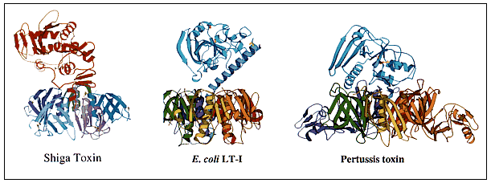
Pathogen Biology
Professor Mark Pallen

Slide 2
Learning Objectives
At the end of this lecture, the student will be able to
provide a definition of terms and jargon related to bacterial pathogenesis
describe the multifactorial nature of bacterial virulence
outline the steps in a successful infection
describe the varied macromolecules implicated in virulence, including endotoxin and exotoxins

Slide 3
Definitions
Bacteria colonise body surfaces (including gut, airways etc) to engage in mutually beneficial (commensal) or neutral associations with host
Constitute the normal microbiota
Infection: a condition in which pathogenic microbes penetrate host defenses, enter tissues and multiply
may be clinically obvious disease or subclinical infection
Pathogens are microbes that cause infection
In a carrier state as pathobionts, can colonise without causing infection, but can still cause disease under certain conditions
Opportunistic pathogens cause disease only when host defenses are compromised or when introduced to deep tissues

Slide 4
Definitions
Figure 28-16
Severity of disease depends on virulence of the pathogen
The more virulent the pathogen, the smaller infectious dose needed to establish infection and cause disease
10² of a highly virulent organism like Streptococcus pneumoniae given intravenously will kill 100% of mice
10⁶ of moderately virulent organism like Salmonella enterica serovar Typhimurium given intravenously needed to achieve same effect

Slide 5
Definitions
The term pathogenesis is applied to the processes leading to infection at levels of tissues, cells, molecules)
The term virulence factor is applied to a feature or structure that contribute to the ability of a microbe to cause disease
Portals of entry for pathogens:
Mucous membranes (gut, respiratory tract, GU tract etc)
Skin
Parenterally

Slide 6
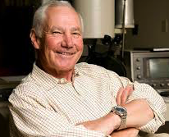
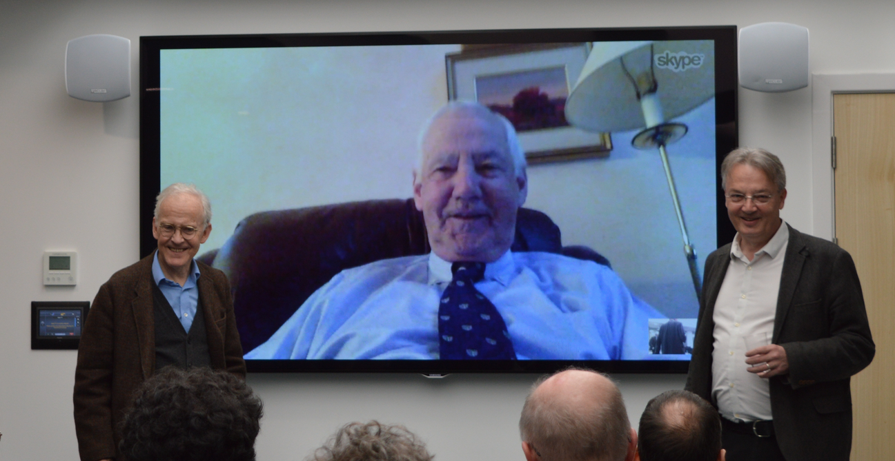
Definitions: Virulence Factor
Something needed to damage host tissues…?
Or just colonise them…?
Falkow’s Molecular Koch’s postulates
A specific gene should be consistently associated with the virulence phenotype.
When the gene is inactivated, the bacterium should become avirulent.
If the wild type gene is reintroduced, the bacterium should regain virulence.
If genetic manipulation is not possible, then induction of antibodies specific for the gene product should neutralize pathogenicity.
[Falkow, 1988. Rev. Infect. Dis. Vol. 10, suppl 2:S274-276]

Slide 7
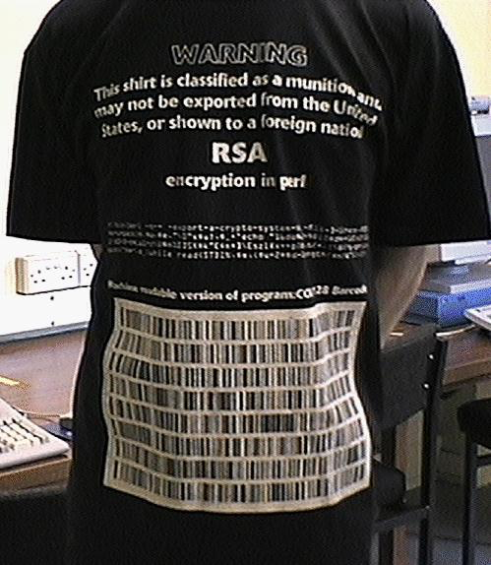
Definitions: Virulence Factor
In fact, virulence factor is a fuzzy over-hyped concept that often includes factors used in colonising the host
Compare with the question “what is a weapon?”
One response to the question “what is a virulence factor?” is “why do you want to know?”
Vaccine or drug development?
Novel diagnostics
Evolutionary perspective
Is cryptography a weapon?
Is the ribosome a virulence factor?

Slide 8
Bacterial Virulence A simplistic view
Infection is a war of bacteria against the host
Some bacterial exotoxins can elicit the features of a bacterial infection when injected as pure proteins, e.g.
tetanus toxin, botulinum toxin, diphtheria toxin, anthrax toxin
Vaccination with toxoids led to a spectacular decline in the incidence of many bacterial infections.
Leading to the simplistic idea that all bacteria need to cause disease is a single toxin.
Analogous to lobbing a grenade at the host

Slide 9
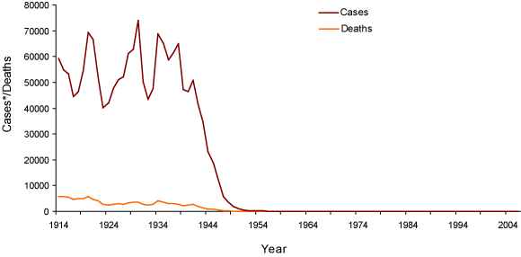
The power of the simplistic view
Diphtheria cases and deaths in England and Wales fell dramatically after introduction of toxoid vaccine

Slide 10
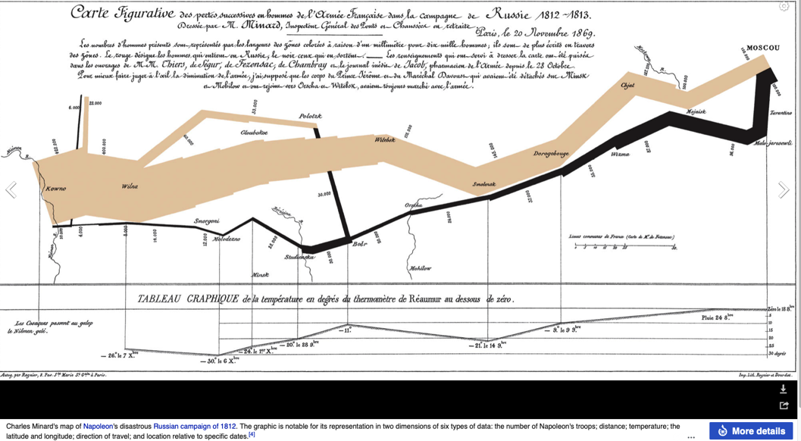
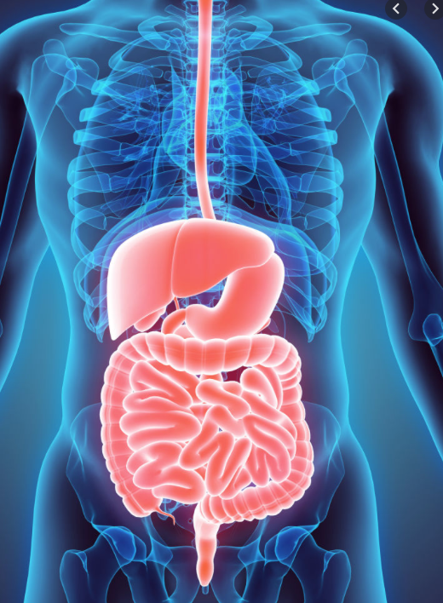
Bacterial Virulence A more sophisticated view
Virulence as a process is
MULTIFACTORIAL
A bacterial army, like a human army, needs more than just its firearms to enter and secure enemy territory…
MULTIDIMENSIONAL
A programme of events organised in time and space
“An army marches on its stomach” Napoleon

Slide 11
Steps in successful infection
Sex comes before disease
acquire virulence genes
Sense environment
and Switch virulence genes on and off
Swim to site of infection
Stick to site of infection
Scavenge nutrients
Survive Stress
Stealth: avoid host defences
Strike-back
damage host tissues
Secrete and Subvert
host cell cytoskeletal and signalling pathways
Survive within host cells
Spread
through cells and organs
Scatter

Slide 12
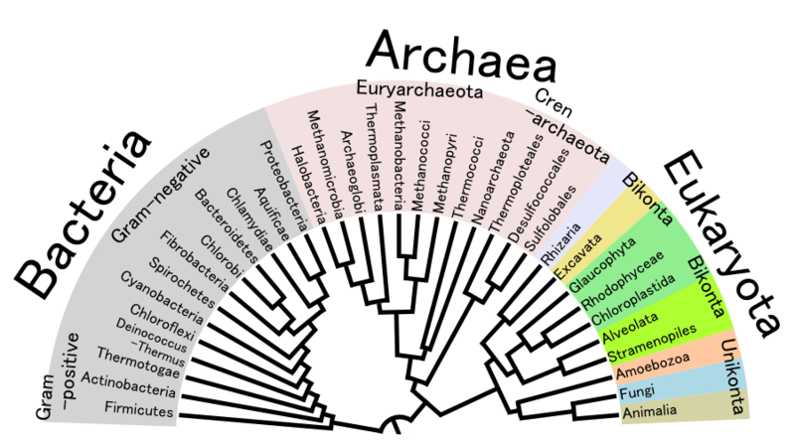
Bacterial Sex drives the evolution of virulence
Molecular phylogeny: ribosomal RNA and other sequences allowed realisation of Darwin’s dream of Tree of Life by Woese et al in 1980s
practical consequence identification of non-culturable bacteria, e.g. Trophyerma whippeli
More recently, genome sequencing suggests horizontal gene transfer has played a large role in shaping bacterial evolution
Web or Net of Life
Genomes as mosaics
Cores (housekeeping genes) and options (niche-specific)
http://commons.wikimedia.org/wiki/File:Phylogenetic_Tree_of_Life.png
Creative Commons Attribution 3.0 Unported license.

Slide 13
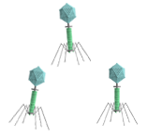
Bacterial Sex acquiring virulence genes
Bacteria have three ways of exchanging DNA
Transformation
cells take up naked DNA
Transduction
phages carry DNA
Conjugation
cells mate through specialised organelles

Slide 14
Bacterial Sex Mobile genetic elements
Transposons
e.g. ST enterotoxin genes
Virulence Plasmids
e.g. type III secretion in Shigella, Yersinia; toxins in Salmonella, E. coli, anthrax
Phage-encoded virulence
e.g. botulinum toxins, diphtheria toxin, shiga-like toxin (linked to lysis), staphylococcal toxins, T3SS substrates.

Slide 15
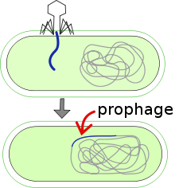
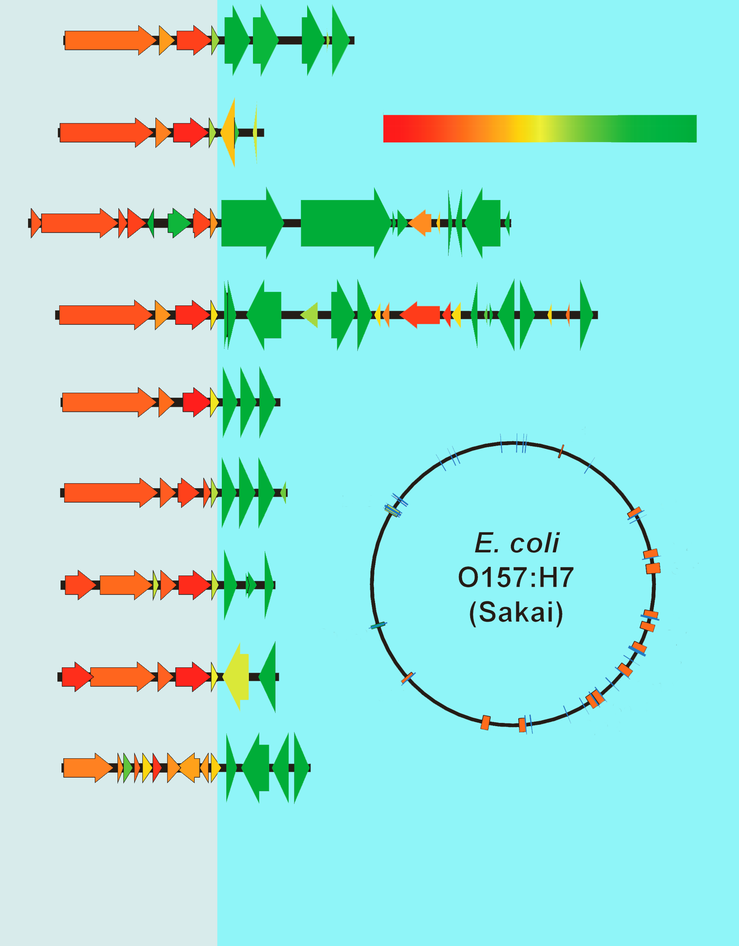
Tobe et al 2006
http://www.pnas.org/content/103/40/14941
http://en.wikipedia.org/wiki/File:Prophage_SVG.svg

Slide 16
Bacterial Sex Pathogenicity Islands
Concept originated from study of uropathogenic E. coli strains
Hacker and colleagues in early 1990s
“Haemolysin islands”, deletable DNA fragments encoding alpha-haemolysin
Also encoded P fimbriae, so renamed “pathogenicity islands”
Rapid acquisition of large blocks of genetic material providing quantum leap to novel complex phenotype
Contrasts with slow tempo of mutation in existing genes
Now extended to many bacterial species
Can encode wide range of virulence factors, e.g. toxins, secretion systems, siderophores, adhesins

Slide 17
Bacterial Sex Pathogenicity Islands: Defining Features
Carriage of (many) virulence genes
Presence in pathogenic versus non-pathogenic strains
Different G+C content from host chromosome
Occupy large chromosomal regions
10s to 100s of kilobases
Compact distinct genetic units
often flanked by DRs, tRNAs, ISs
Presence of (cryptic) mobility genes
[Unstable, prone to deletion]

Slide 18
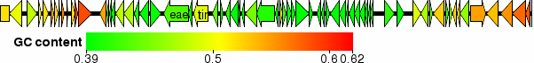
LEE
O157
K12
(colibase.bham.ac.uk)
The Locus for Enterocyte Effacement or LEE is a pathogenicity island found in EPEC and EHEC
The LEE encodes a type III secretion system (T3SS)

Slide 19
Sense environment
Bacteria can sense changes in environment
e.g. in temperature, nutrient availability, osmolarity, cell density (“quorum sensing”).
In simplest cases, change in intracellular concentration of ion linked directly to gene expression
e.g. fall in intra-cellular iron levels relieves DtxR-mediated repression of diphtheria toxin gene
In more complex cases, sophisticated signal transduction cascades allow bacteria to regulate gene expression in response to environmental cues
the pathogen as an information processor

Slide 20
Switch virulence factors on and off
Gene expression is regulated
Inducible versus constitutive genes
Wasteful if always constitutive
Artificial constitutive constructs decrease fitness
Co-ordinate gene regulation
Operon
Stimulon, e.g. The oxidative stress response
Regulon, e.g. The OxyR regulon
Co-ordinate regulation of virulence
in response to in vivo signals

Slide 21
Switch virulence factors on and off A multi-layered hierarchy
Changes in DNA sequence
Gene amplification
Genetic rearrangements
e.g. Hin flip-flop control of flagellar phase variation
Transcriptional Regulation
Activators and Repressors
(helix-turn-helix motif)
mRNA folding and stability
Translational Regulation
Post-translational Regulation
Stability of protein, controlled cleavage
Covalent modifications
e.g. phosphorylation in two-component sensor-regulator systems

Slide 22
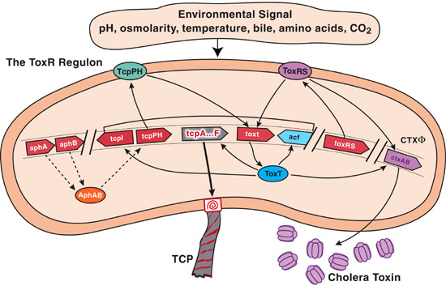
The ToxR regulon in Vibrio cholerae
http://www.uthsc.edu/molecular_sciences/directories/faculty/j_bina.php

Slide 23
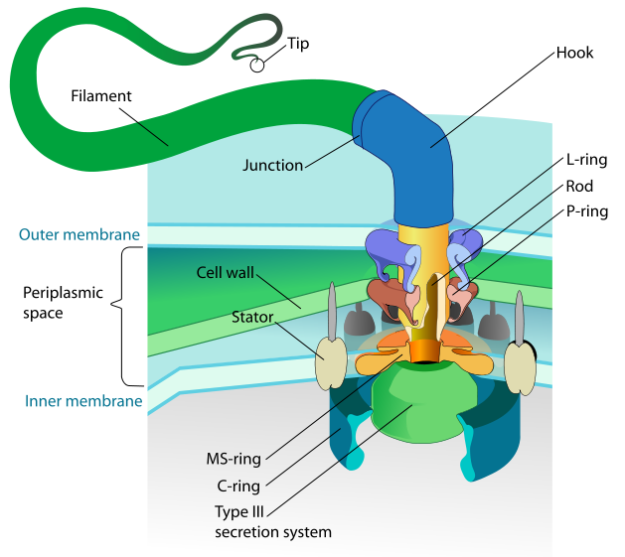
Swim
Many bacterial pathogens are motile
E. coli, Salmonella, Campylobacter, Helicobacter, spirochaetes
Motility crucial for virulence in some cases
Usual organelle of motility is flagellum
Variants
Twitching motility
Swarming
http://en.wikipedia.org/wiki/File:Flagellum_base_diagram_en.svg

Slide 24
Stick
To avoid physical and immunological removal, bacteria must adhere to
mucosal surfaces and extracellular matrix
solid surfaces
other bacteria
Example
S. mutans produces dextran glycocalyx to stick to teeth
Actinomyces uses fimbriae to attach to this glycocalyx
Options
Direct interaction with host receptors (typically sugars)
Molecular bridging e.g. via fibronectin
Adherence plus manipulation of host cell signalling and cytoskeleton leading to intimate attachment or invasion

Slide 25
Scavenge nutrients
Free iron levels very low in body fluids
Acute phase response causes further drop
Iron overload increases susceptibility to infection
Many different bacterial systems for scavenging iron
Siderophores chelate available iron & transport it into bacteria
Iron can be scavenged direct from host iron-binding proteins, e.g by lactoferrin-binding proteins
Often co-ordinately regulated e.g. by fur locus in E. coli
Some pathogens avoid problem by cutting out need for iron, e.g. Treponema pallidum
Iron used to regulate aggressive virulence factors
Diphtheria toxin (DtxR repressor)
Shiga-like toxin
Pseudomonas aeruginosa exotoxin A

Slide 26
Survive Stress
In addition to nutrient-limitation stress, pathogens face many other stresses
Acid stress within stomach
Heat shock during fever
Oxidative stress within phagocytes
Stress response proteins, such as chaperonins feature as immunodominant antigens
Detoxification proteins play a role in virulence
e.g. periplasmic Cu,Zn-superoxide dismutases
Infectious dose for enteric pathogens much lower in achlorhydria (no need to overcome acid stress)

Slide 27
Stealth avoid host defences
IgA proteases
metalloproteases active against IgA
Immunoglobulin-binding proteins
e.g. protein A of S. aureus
Resist complement, opsonisation (serum resistance)
Many species only virulent when capsule present:
Streptococcus pneumoniae, Klebsiella pneumoniae, Hemophilus influenzae, Bacillus anthracis, Yersinia pestis (protein).
LPS and surface or outer membrane proteins also play role
Cell wall of Mycobacterium tuberculosis helps resist digestion after phagocytosis; triggers granuloma formation
Immunoglobulin-binding protein

Slide 28
Stealth: avoid host defences
Antigenic or phase variation
Antigens on surface of pathogen are recognized by host immune response
Some pathogens can change cell surface antigens to evade immune response
Involves surface structures (LPS, capsules, pili, flagella) and secreted proteins
Variety of mechanisms
slip-strand mispairing
flip-flop
cassettes
Adopt cryptic niche
inside phagocytes or in biofilm
Antigenic mimicry
e.g. sialic acid capsule of group B meningococcus
Antigenic diversity
>60 different Salmonella LPS O side-chains

Slide 29
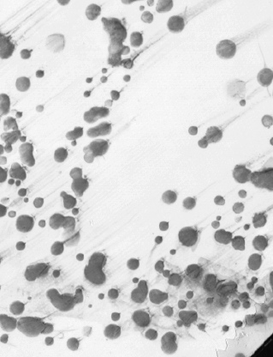
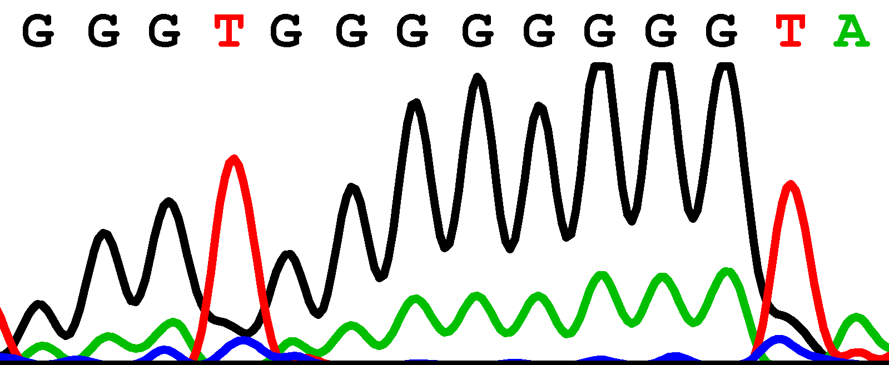
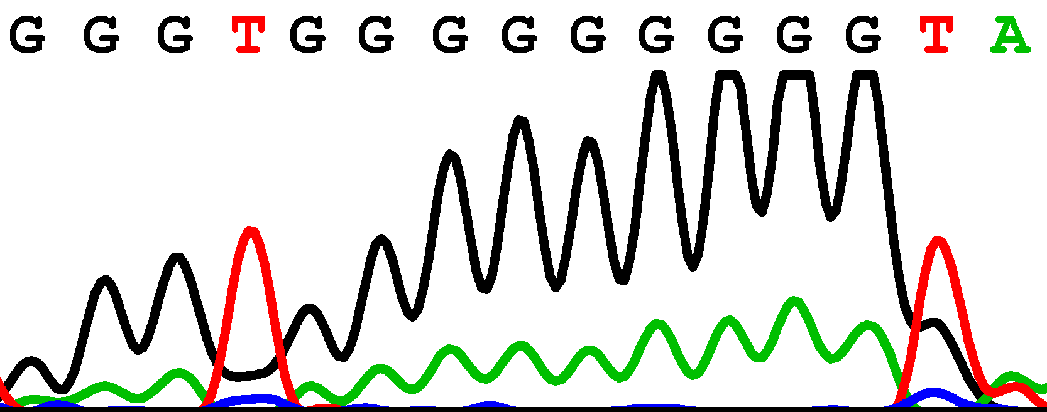
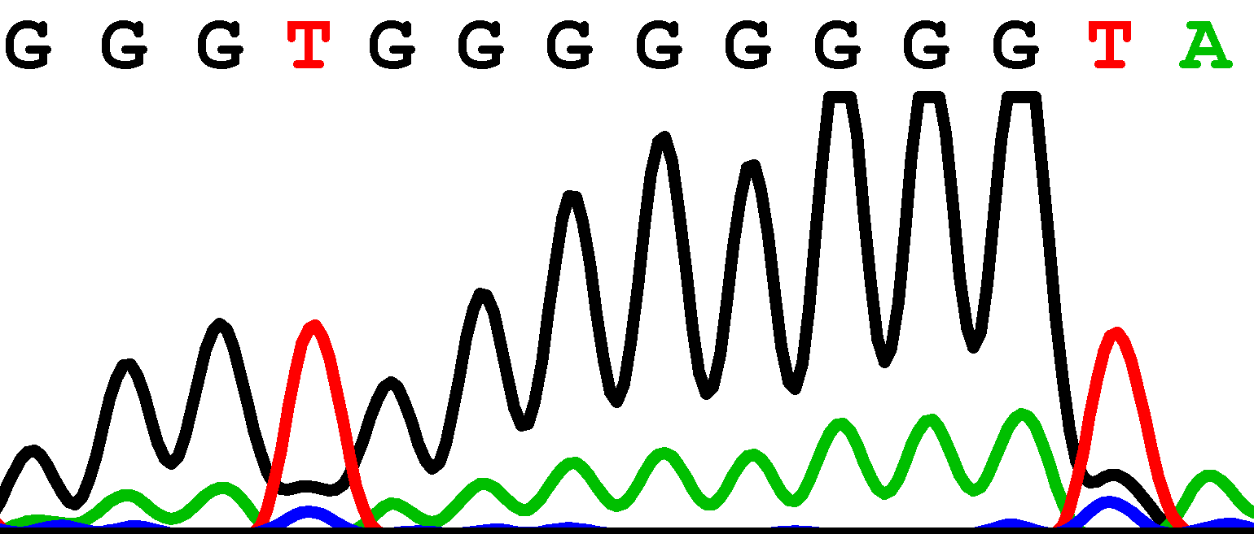
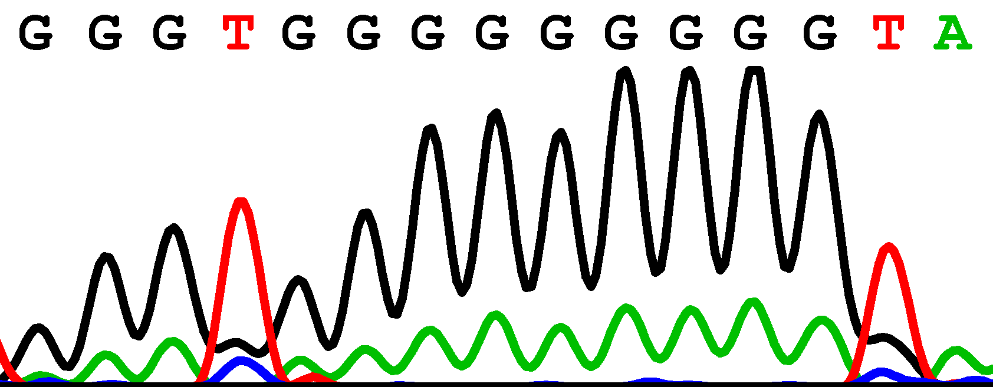
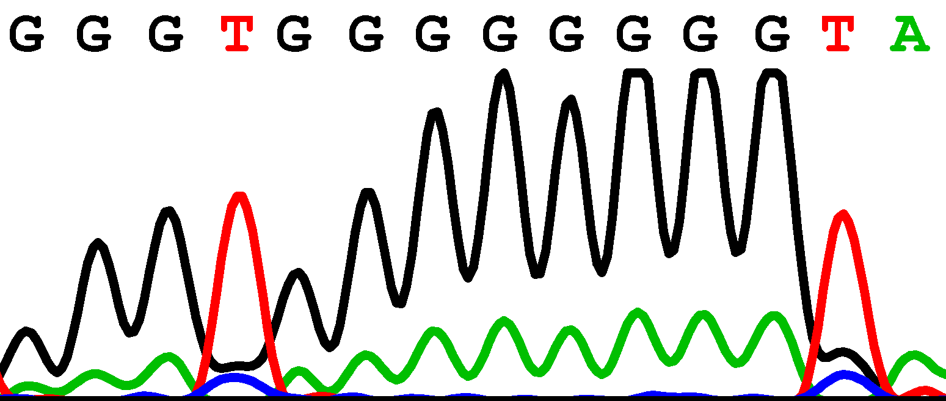
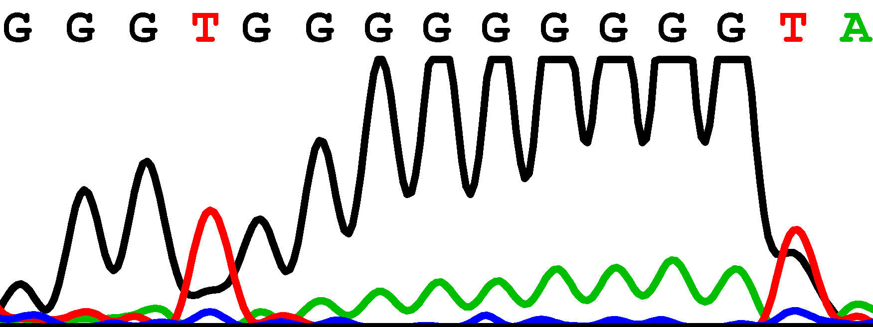
Phase variation in Campylobacter jejuni
Sequence of phase-variable locus
8Gs
9Gs
Colony blotting of wild type
population with cholera toxin
WlaN expressed in vitro and shown to be a beta-1,3 galactosyltransferase
Linton, et al Mol Micro (2000) p501

Slide 30
Strike-back: Damage host tissues
Endotoxin
a component of the Gram-negative cell wall
Exotoxins
soluble secreted proteins, include
exoenzymes
toxins acting on cell membranes
toxins active inside cells
superantigens

Slide 31
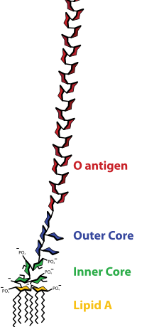
Endotoxin of Gram-negatives

Slide 32
Strike-back Endotoxin
Actions of Endotoxin
Pyrogenicity
Leucopenia then leucocytosis
Hypotension
“Gram-negative Shock”
Life-threatening complication of septicaemia
e.g. in meningococcal infection, in ITU or oncology patients
Endotoxic shock seen with dirty intravenous equipment

Slide 33
Strike-back Exotoxins
Secreted proteins with enzymatic activity
Transported in body fluids
Various effects
Cytotoxins: Kill or damage host cells.
Neurotoxins: Interfere with nerve impulses
Enterotoxins: Interfere with gastrointestinal tract.
Antitoxin antibodies provide immunity
Toxoids: toxins that have been denatured by heat or chemicals.
Used as vaccines for e.g. diphtheria and tetanus

Slide 34
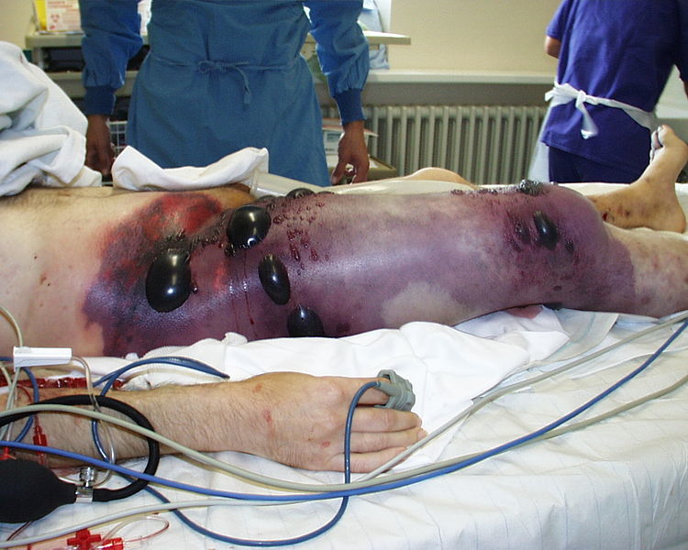
Exoenzymes
phospholipases (lecithinases) degrade membranes, e.g. Clostridium perfringens alpha toxin in gas gangrene
coagulase produces clots to wall off infection from immune response
kinases break down clots
hyaluronidase and collagenase break down connective tissue
http://commons.wikimedia.org/wiki/File:Gas_gangrene.jpg

Slide 35
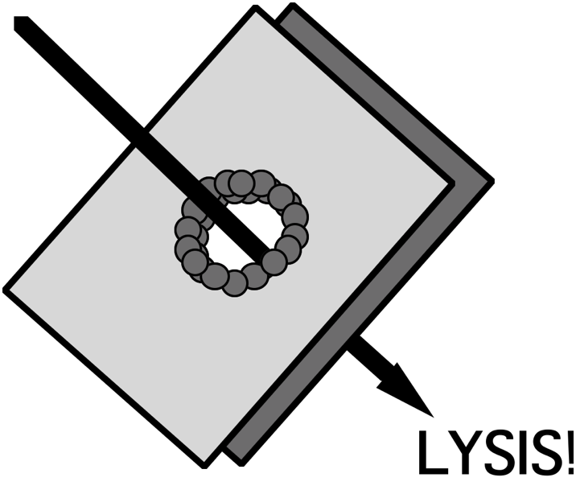
Pore-forming Toxins
RTX family, produced by Gram-negative pathogens
Lyse cells by insertion into cell membrane
e. g. E. coli haemolysin
Sulfhydryl/thiol-activated family, produced by Gram- positive pathogens
e.g. Listeriolysin O mediates escape from macrophage vacuole; activity triggered by low pH

Slide 36
Zinc metalloendoproteases
Neuropathologic effects
Inhibit release of neurotransmitters
Delivery-dependent disease presentations
Botulinum toxin
causes flaccid paralysis; cleaves synaptobrevin to inhibit release of ACh in peripheral nerves
Tetanus toxin
spastic paralysis: cleaves synaptobrevin to inhibit release of ACh in CNS.

Slide 37
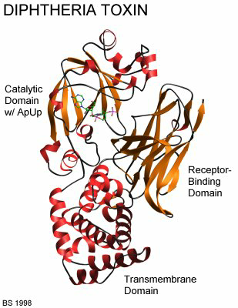
Toxins active inside cells
Toxins often consist of translocation and binding B subunit that delivers the active A subunit into the host cell cytoplasm
Example of AB toxin: diphtheria toxin, an ADP-ribosyltransferase that interferes with protein synthesis

Slide 38
AB5 Toxins

Slide 39
Pyrogenic Exotoxins
“Superantigens”
Potent activators of T-cells
Suppress B-cell responses
Enhance susceptibility to LPS
Stimulate cytokine production
Examples:
Staphylococcus enterotoxin B (SEB)
S. aureus toxic shock syndrome toxin

Slide 40
Secrete and Subvert
Bacterial contact-dependent secretion systems
Type III, Type IV, Type V, Type VI secretion systems (T3SSs etc)
Complex multi-protein systems for translocating bacterial protein (or DNA) from bacterial cell cytoplasm into the cytoplasm of a target cell (eukaryotic cells, or for some T4S and T6S, bacteria as well)
Wide variety of effector proteins now described with wide-ranging effects on eukaryotic cell biology
cytoskeleton; inflammatory responses; TJ barrier function; cell cycle; mitochondrial function; apoptosis

Slide 41
Survive within cells
Pathogens adopt intracellular lifestyles within phagocytes or non-phagocytic cells
Variety of mechanisms
Modification of the phagocytic vacuole
Inhibition of lysosomal fusion
Growth within target cell and release
Escape from the vacuole by lysis of vacuolar membrane

Slide 42
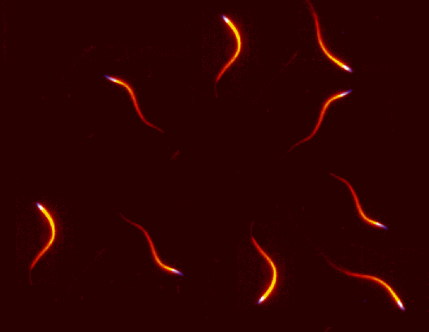
Spread
…through cells and organs:
within macrophages, e.g. in typhoid
through blood (need to be complement-resistant)
movement of bacteria within/between cells via host actin filaments
Shigella: IscA
Listeria monocytogenes: ActA

Slide 43
Scatter
Pathogens usually depart by a specific route
Portal of exit influences dissemination of infection
respiratory – mucus, sputum, nasal drainage, saliva
skin scales
faeces
urogenital tract; urine or via sexual contact
blood-borne infection
Transmission, virulence and evolution: dogmas
balanced pathogenicity
being too virulent is no good
high virulence is a sign of recent emergence of a pathogen
pathogens evolve towards symbiosis

Slide 44
Scatter
Counter-arguments
Where pathogens rely on spread through biting arthopods, high bacteraemias advantageous
Where pathogens rely on shedding into water, highest possible shedding rates good for pathogen
Where pathogens cause incidental disease (e.g. Legionella) no selective pressure towards low virulence
Virulence as a local adaptation (why meningitis?)
Vaccines and effect on virulence

Slide 45
Steps in successful infection
Sex comes before disease
acquire virulence genes
Sense environment
and Switch virulence genes on and off
Swim to site of infection
Stick to site of infection
Scavenge nutrients
Survive Stress
Stealth: avoid host defences
Strike-back
damage host tissues
Secrete and Subvert
host cell cytoskeletal and signalling pathways
Survive within host cells
Spread
through cells and organs
Scatter

Slide 46
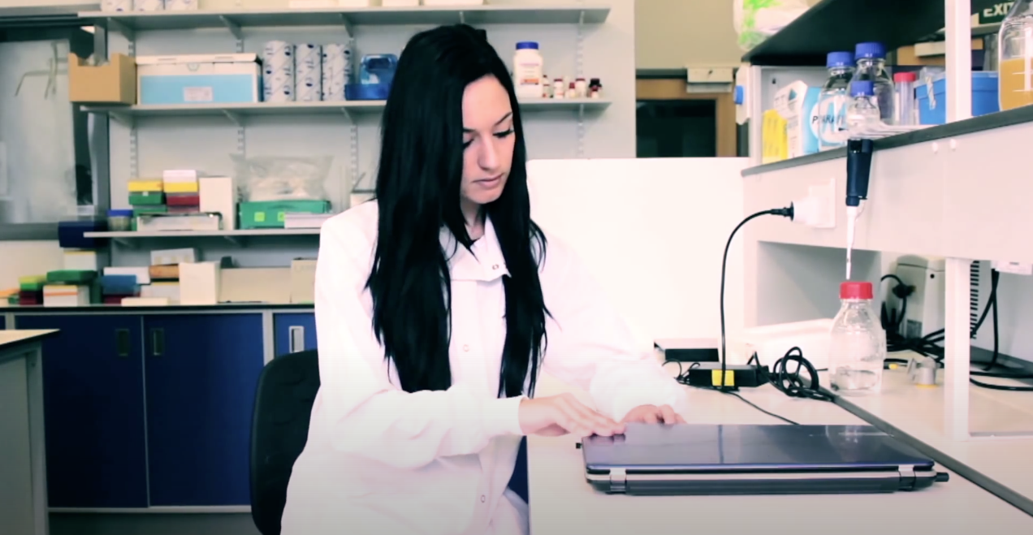
https://www.youtube.com/watch?v=swoDROzsjXg

Slide 47
Further reading
https://www.ncbi.nlm.nih.gov/books/NBK8526/
https://pmj.bmj.com/content/78/918/216.full
https://courses.lumenlearning.com/microbiology/chapter/how-pathogens-cause-disease/
https://www.ibiology.org/microbiology/pathogenic-bacteria-distinguishes-pathogen-non-pathogen/

